Slide 1
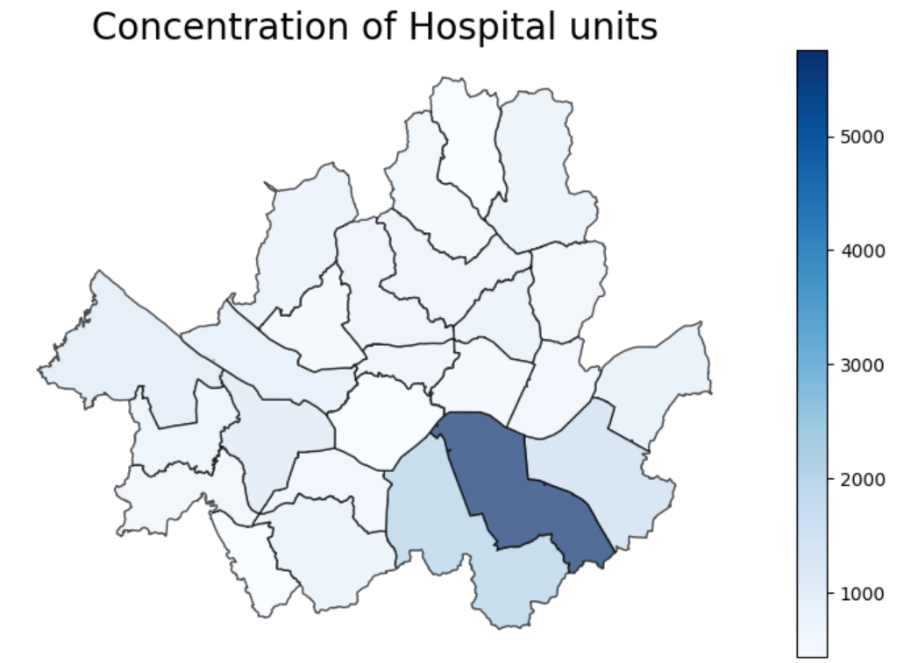
Indicator #1: Number of Hospital Buildings
Overview of indicator
Number of Hospitals
Assesses the concentration of hospital units in Seoul based on the number of hospital structures present
Data sources
Data source is from a Naver study done in 2022. The scope of data covers 20,000 hospitals in Seoul’s districts and gives information on the number of hospitals in each district. Its contents also include the number of residents served by each hospital. This data was converted into a csv file and is publicly available: https://blog.naver.com/lghmms/222758076422
Analysis results
The district with the greatest number of hospital units is Gangnam-gu, followed closely by Seocho-gu and Songpa-gu. The visualization indicates a high disparity in healthcare accessibility and highlights the different levels of emergency preparedness and health resource allocation between the districts. Because of unequal distribution, some districts might have a higher risk of vulnerability to outcomes of hazards and might not get treatment when encountering exposure to risk elements. Thus, districts with a lower concentration of hospitals might have higher expected losses
Figure 1: Hospital Units

Slide 2
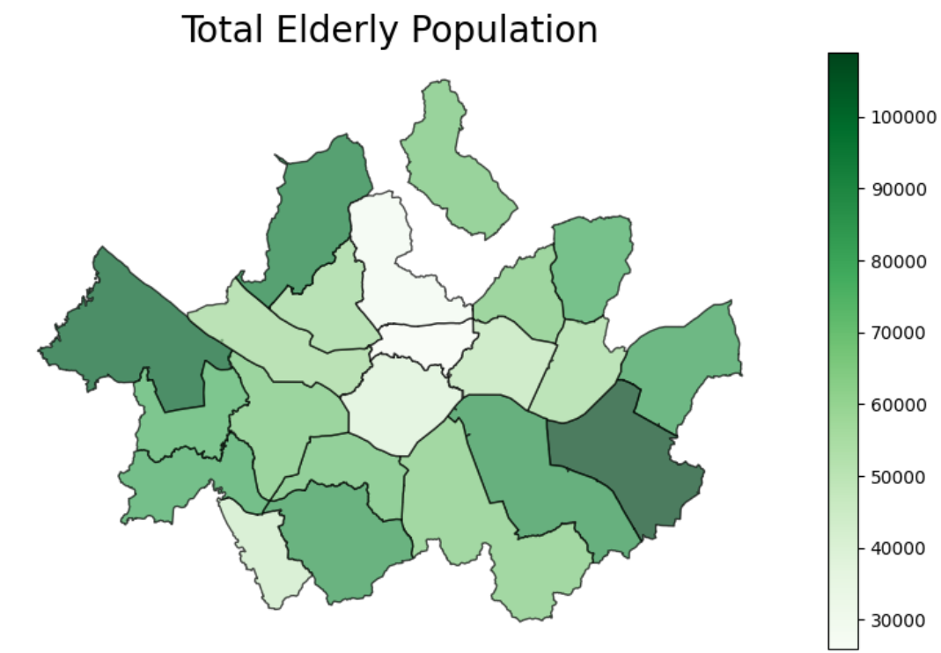
Indicator #2: Elderly Population
Overview of indicator
Total Elderly Population
Interprets the total elderly population of those over 65 years old and assesses the distribution of this demographic of residents throughout Seoul
Data sources
Data source is from Seoul metropolitan government’s open data site. The specific data used is based on information about the elderly demographic in 2024. The scope of data covers all of Seoul’s districts with demographics also calculated for 2023. Its contents are inclusive of the genders of the elderly population as well as the population of registered aliens within this demographic. This data is publicly available: https://data.seoul.go.kr/dataList/10020/S/2/datasetView.do?stcSrl=10020
Analysis results
Songpa-gu has the highest concentration of elderly population followed closely by Gangseo-gu and Eunpyeong-gu. This greatly helps with doing vulnerability analysis as this demographic is highly vulnerable to many health-related risks. Understanding their distribution throughout Seoul’s districts can also help reduce or prevent risk during times of crisis and emergency like virus outbreaks or natural disasters.
Figure 2: Elderly Population

Slide 3
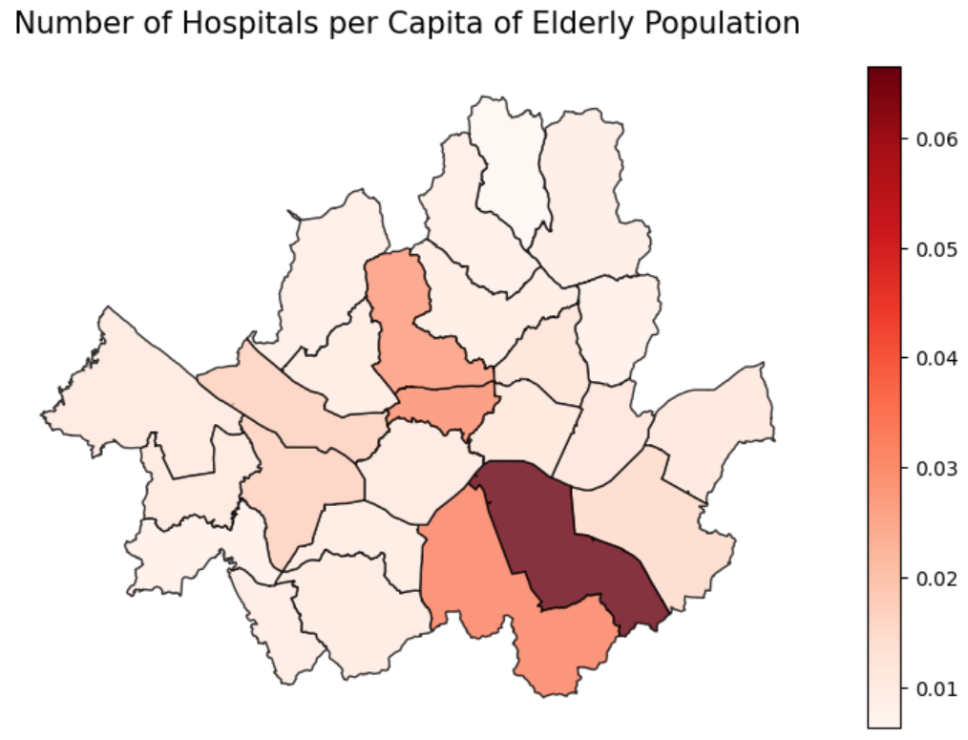
Indicator #3: Hospitals per Capita
Overview of indicator
Number of Hospitals Per Capita for Elderly Population
Examines the number of hospitals available per capita of the elderly population in Seoul districts to interpret the accessibility of healthcare for the elderly
Data sources (combination of the other sources)
https://blog.naver.com/lghmms/222758076422
https://data.seoul.go.kr/dataList/10020/S/2/datasetView.do?stcSrl=10020
Analysis results
Gangnam-gu has the highest number of hospitals per capita of the elderly population followed closely by Seocho-gu, Jongno-gu, and Jung-gu. This gives insight into Seoul’s healthcare infrastructure and its capacity to provide services to its elderly population. Districts with more hospitals per capita can better respond to risks and health hazards. Therefore, measures should be taken to increase the healthcare capacity of the other districts to help better respond to risk and protect this vulnerable population.
Figure 3: Hospitals Per Capita of Elderly Population

